Slide 1

Challenges of Glaucoma Care in the Himalayas
(Tibet and Nepal)
Suman Thapa MD, PhD
Kathmandu, Nepal

Slide 2
Worldwide problem
Glaucoma
  Second leading cause of blindness after cataract (Resnikoff, WHO 2002)
  Leading cause of irreversible blindness

Slide 3
Blindness from Glaucoma
In 2010, it is estimated that glaucoma will affect approximately 60.5 million (Quigley, 2006)
  59 % will be women
  47% will be Asian
Primary open-angle glaucoma → 44.7 million
  55% will be women
  4.5 million will be bilateral blind (about 10%)
Primary angle closure glaucoma → 15.7 million
  70% will be women
  87% will be Asian
  3.9 million will be bilateral blind (about 25%)
Regarding angle closure glaucoma
  More devastating and blinding disease → 3x more than POAG (Foster, BJO 2001)
  Able to treat the pathophysiological mechanism if detected earlier

Slide 4
TIBET
Blindness and eye diseases in Tibet
15 900 people enumerated (response rate of 79.6%)
Adjusted Prevalence of Blindness
(presenting better eye VA < 6/60) 1.4%
Glaucoma (2.5%).
Cataract (50.7%),
Macular degeneration (12.7%)
Corneal opacity (9.7%).
S Dunzhu et al. Br J Ophthalmol 2003

Slide 5
NEPAL
Between China and India
Population : 26.6 Million (2011)
Area: 147,181 sq. km
Health Budget: Aprox. 7 % of the total budget
GDP $450

Slide 6
Causes of Blindness: Population based studies
Comparison 1981 and 2010

Slide 7
Human Resource & Eye Care Infrastructure in Nepal
 | 1981 | 2001 | 2011
Ophthalmologists | 7 | 78 | 150
Supporting Medical Staff (Ophthalmic Assistants, Optometrist, Orthoptists, Ophthalmic Nurses, Eye Health Workers, Technicians) | 4 | 325 | 475
General (admin, managers) | 5 | 45 | 275
Eye Hospitals | 1 | 16 | 21
Eye Departments | 4 | 6 | 17
Community (District) Eye Care Centers | 0 | 25 | 63
Ratio : Population/Ophthalmologist | 2m | 0.3 m | 0.2 m

Slide 8

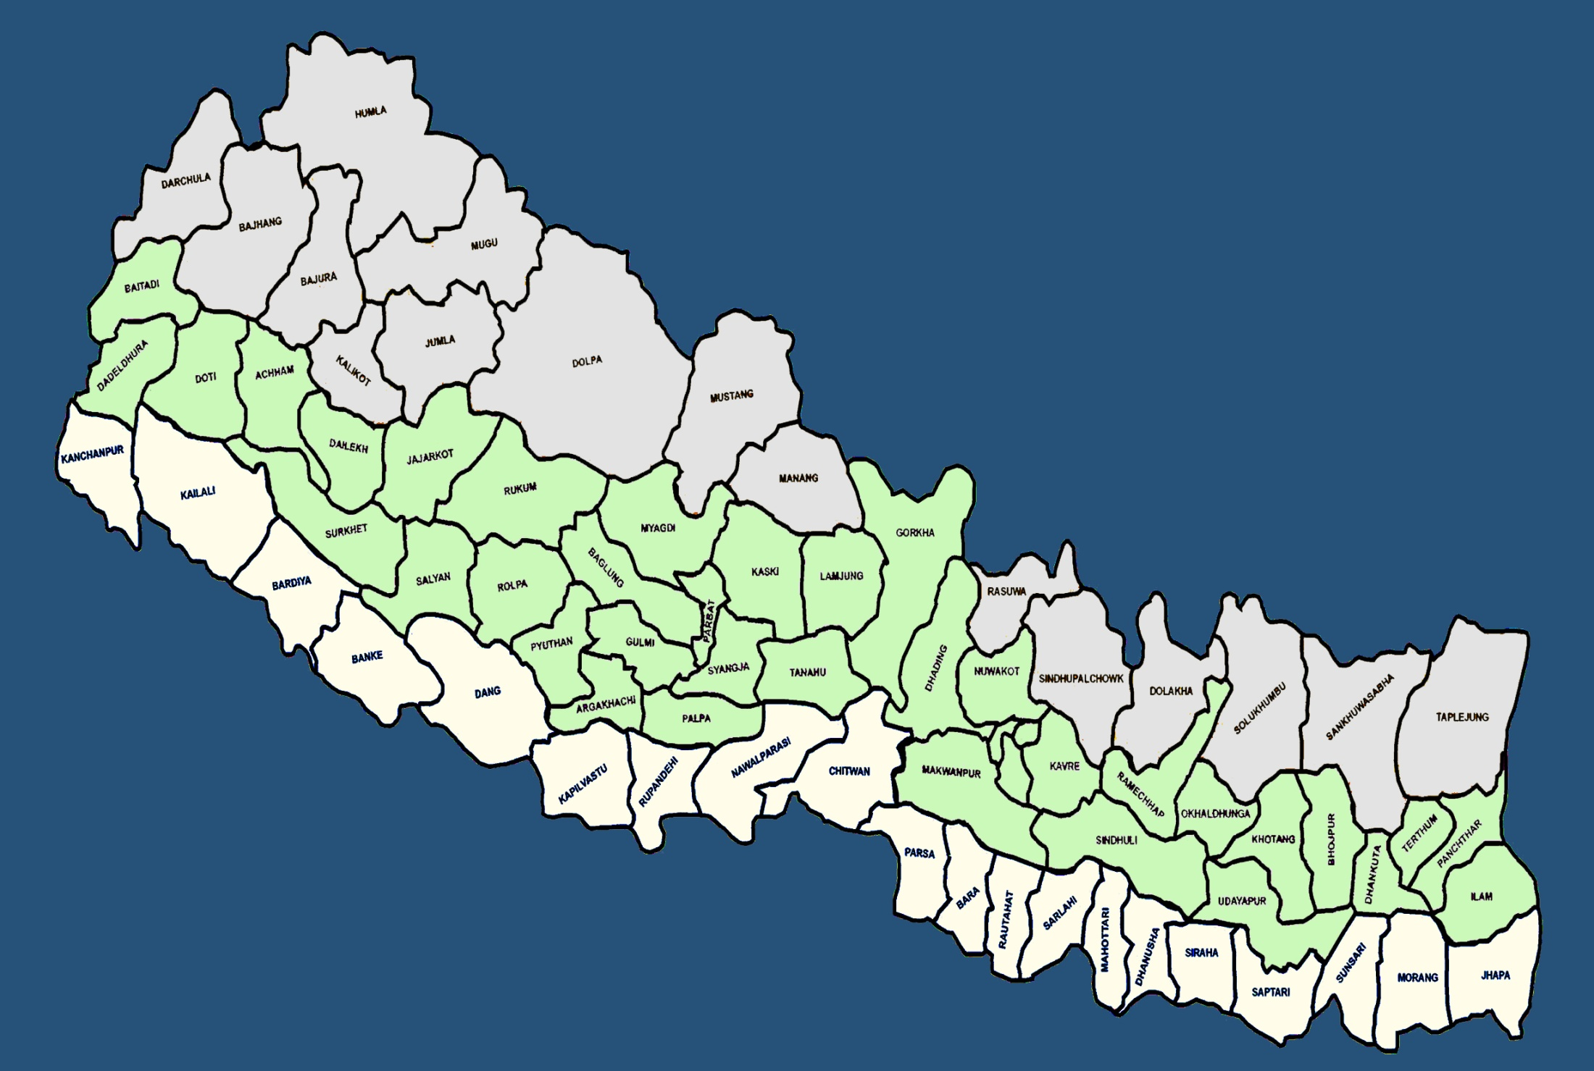
EYE CARE INFRASTRUCTURE IN NEPAL
Eye Hospital = 21
Eye Department = 17
Community Eye Centre = 63

Slide 9
Understanding the burden of Glaucoma
Hospital Based Data (2011)
Results from a Population Based Study (2010)
Clinical Information from these data and the Implications
Challenges & Strategies adopted

Slide 10
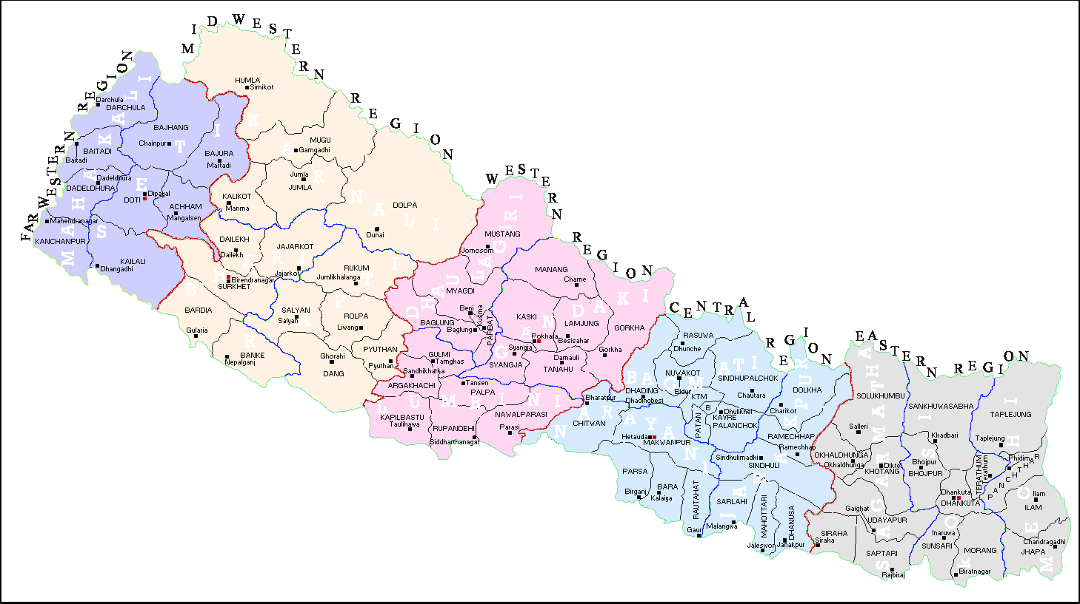
Glaucoma Diagnoses ( 1 year) 2011
Hospital Based Data
PACG = POAG
 | FAR WEST (GETA) | MID WEST (NGJ) | WEST #(LEI) | CENTRAL (TIO) | EAST (LAHAN)
POAG | 459 (48.1) | 435(48.6) | 319 (30.5) | 246 (38.2) | 1110( 39.4)
PACG | 99 (10.4) | 297 (33.2) | 499 (47.8) | 218 (32 ) | 899 (32.0)
Sec G | 377 (39.6) | 163 (18.2) | 210 (20.2) | 86 (19.4) | 422 (15.0)
CG | 19 (1.9) | - | 15 (1.5) | 28 (11.4) | 28 (14.0)

Slide 11
DATA from Tilganga Institute of Ophthalmology, Kathmandu (2011)
 | POAG | PACG
Number | 246 ( 38.2 % ) | 218 ( 32 % )
AGE | 65.8 | 54.6
SEX | M > F | F > M
IOP | 31.4 | 38.1
CDR | 0.6 | 0.8
VF DEFECTS | 82.5 % | -
VA | > 6/36 (85%) (both eyes) | < 3/60 (85.5 %) (worse eye)
79 % PACG were asymptomatic; Sec Glaucoma: NVG

Slide 12
Population Studies for Blindness
Designed specifically to estimate the causes of avoidable blindness: (Cataract, Trachoma, Vitamin A def, Trauma)
The NBS 1981 / RAAB 2010 estimated that glaucoma accounted for 3.8 % & 5.0 % of the total blindness (underestimation, design)

Slide 13

Bhaktapur Glaucoma Study, Nepal (2007-2010)
Population based cross sectional study
ISGEO definitions for glaucoma
Represents a district in Nepal

Slide 14
Results
  Prevalence 1.8 % (95% CI = 1.68 – 1.92)
  POAG (1.2 %) > PACG (0.4 %)
  Age was a RF (2.4 % : 60-69 years; 10.3% : > 80 years)
  No difference in gender
  Myopia , HTN, DM were not RFs for POAG
Thapa SS et al. Ophthalmology 2012

Slide 15
Prevalence of Glaucoma in South Asia
 | Prevalence %
Study Population | Age | All | POAG | PACG | Ratio of POAG to PACG
Bangladesh, Dhaka | 40 + | 3.1 | 2.5 | 0.4 | 6.3
West Bengal, East India | 50 + | 3.3 | 3.1 | 0.2 | 10.00
ACES, South India | 40 + | 2.6 | 1.2 | 0.5 | 2.4
APEDS, South India | 40 + | - | 2.6 | 1.1 | 2.4
CGS, South India | 40 + | - | 1.6 | 0.9 | 1.4
Sri Lanka | 40 + | 1.0 | 2.3 | 0.5 | 4.6
Burma | 40 + | - | 2.0 | 2.5 | 0.8
BGS, Nepal | 40 + | 1.8 | 1.2 | 0.4 | 3.0
ACES: Aravind Comprehensive Eye Survey
APEDS: Andhra Pradesh Eye Disease Study
CGS: Chennai Glaucoma Study
BGS: Bhaktapur Glaucoma Study

Slide 16
Comparison
Age, Sex, IOP, CCT and vCDR
Characteristics | Normal | POAG | P value | PACG | P value
Age | 54.60 ( ± 0.20) | 68.53 ( ± 1.63) | < 0.001 | 71.24 ( ± 1.67) | < 0.001
Sex, M / F | 1695 / 1994 | 26/25 | 0.483 | 4/13 | 0.086
IOP | 13.30 ( ± 0.04) | 13.57 ( ± 0.34) | 0.400 | 16.00 ( ± 1.11) | < 0.001
CCT | 537.88 ( ± 0.60) | 527.73 ( ± 4.58) | 0.053 | 552.12 ( ± 45.65) | 0.11
VCDR | 0.26 ( ± 0.002) | 0.62 ( ± 0.02) | < 0.001 | 0.55 ( ± 0.05) | < 0.001
M: Male, F: Female, IOP: Intraocular pressure, CCT: Central Corneal Thickness,
VCDR: Vertical Cup Disc Ratio

Slide 17
Ocular Biometric Measures
Different population based studies
 | Nepalese (n = 685) | South Indian (n = 419) | Chinese (n = 531) | White Americans (n = 170) | African- Americans (n = 188)
Sex (M : F) | 315 : 370 | 210: 209 | 236 : 295 | 82 : 88 | 55 : 133
Axial length (mm), mean (SD) | 22.62 (0.90) | 22.76(0.78) | 23.32(1.38) | 23.35(1.38) | 23.14(0.87)
95% CI difference in means |  | - 0.24 to - 0.03 | - 0.83 to - 0.57 | - 0.90 to - 0.56 | - 0.66 to - 0.37
p- value |  | 0.008 | < 0.001 | < 0.001 | < 0.001
.
Thapa SS et al. Optometry and Visual Science 2011

Slide 18
Demographics of Glaucoma Cases
 | All (n) | Males (n) | Females (n) | M:F Ratio | Median Age | Previously Diagnosed (%)
POAG | 51 | 26 | 25 | 1.04 | 68.53 | 2 (3.92)
PACG | 17 | 4 | 13 | 0.30 | 71.23 | 5 (29.41)
Secondary Glaucoma | 7 | 6 | 1 | 6.0 | 64.00 | 4 (57.14)
Total | 75 | 36 | 39 | 0.92 | 70.00 | 11 (14.67)
 | ISGEO Diagnostic Category (%) 1: Structural and functional evidence 2. Advanced structural damage where reliable field testing is not possible 3. Optic disc not seen due of media opacity, the IOP > 99.5th percentile, evidence of filtering surgery
 | 1 | 2 | 3
POAG | 45 (88.24) | 5 (9.80) | 1 (1.96)
PACG | 12 (70.59) | 5 (29.41) | 0 (0.00)
Sec Gl | 2 (28.57) | 4 (57.14) | 1 (14.29)
Total | 59 (78.67%) | 14 (18.67) | 2 (2.66)
POAG: Primary- open angle glaucoma, PACG: Primary-angle closure glaucoma

Slide 19
Visual Acuity Distribution of Glaucoma Cases
 | N | Visual Acuity
 |  | Normal vision (%) | Low vision (%) | Bindness (%)
Age group
40 - 49 Year | 4 | 3 (75.0) | 1 (25.0) | 0 (0.0)
50 - 59 Year | 10 | 8 (80.0) | 2 (20.0) | 0 (0.0)
60 - 69 Year | 20 | 15 (75.0) | 2 (10.0) | 3 (15.0)
70 - 79 Year | 31 | 17 (54.8) | 7 (22.6) | 7 (22.6)
≥ 80 Year | 10 | 5 (50.0) | 1 (10.0) | 4 (40.0)
Sex
Male | 36 | 24 (66.7) | 5 (13.9) | 7 (19.4)
Female | 39 | 24 (61.5) | 8 (20.5) | 7 (18.0)
Types of Glaucoma
POAG | 51 | 38 (74.5) | 6 (11.8) | 7 (13.7)
PACG | 17 | 10 (58.8) | 4 (23.5) | 3 (17.7)
Secondary Glaucoma | 7 | 0 (0.0) | 3 (42.9) | 4 (57.1)
All | 75 | 48 (64.0) | 13 (17.3) | 14 (18.7)
Low vision has been defined as a best corrected VA of less than 6/ 18 (20/60, 0.3), but not less than 3/60 (20/400, 0.05) in the better eye. Visual acuity was based on the eye with glaucoma in unilateral cases and on the better eye in bilateral cases.

Slide 20
Clinical Information
&
Implications

Slide 21
Normal IOP ≈ 13 mmHg
18 mmHg should be considered on the higher side
Normal v CDR 0.2
0.7 should be viewed with suspicion
CCT influences the measurement of IOP

Slide 22
85.7 % had IOP within the normal range
79 % had visual field defects at the time of diagnosis
96 % had not previously been diagnosed
Angle closure glaucoma > 70 % asymptomatic
> 90 % were not aware of Glaucoma

Slide 23
Glaucoma 5.2% total blindness
( > the estimate of 1981 NBS: 3.8 % )
Visual morbidity PACG > POAG (3 X )

Slide 24
Prevalence of Glaucoma in Bhaktapur district
Represents primarily a ‘ Newari ’ ethnic race
Although the ‘ Newari ’ race constitute a large proportion of the countries population, the results from the BGS does not represent the epidemiology of glaucoma in Nepal

Slide 25
Separate screening programs for glaucoma are not necessary in Bhaktapur
Target population > 60 years,
‘Opportunistic screening ‘ cataract screening programs
Optic discs have to be examined (0.7 VCDR)
Short axial lengths noted during Biometry for cataract surgery, should undergo gonioscopy
Measuring IOP has a limited role
.
Thapa SS et al. BMC Ophthalmology 2008

Slide 26
PACG
Majority ( 70% ) were asymptomatic (HBS , BGS)
Gonioscopy has to be performed for correct diagnosis
High Risk Patients (HBS, BGS)
Females > 50 years, short axial lengths
Severe visual impairment at presentation (HBS)
( >> POAG)

Slide 27
Role of the lens / formation of cataract in the pathogenesis of PACG has to be considered (BGS)
Early cataract removal may prevent progression to / of PACG in high risk patients

Slide 28
Challenges
and
Strategies Adopted

Slide 29
Burden of Blindness from Glaucoma in Nepal
88,800 Nepalese 30 years and older have definite glaucoma
Three times more = glaucoma suspects
Almost 400,000 Nepalese have definite or probable glaucoma
2010 Nepal Mid Term Report, Vision 2020

Slide 30
Challenges
Aging Population
Geographic terrain
Limited Human Resource
Poverty, Illiteracy
Glaucoma, the disease

Slide 31
Training Programs for Glaucoma
Ophthalmologist
Residency Program (1994): University Hospital
Short - term observer training (2005) – 1 month
Glaucoma Fellowship (2013) – 1 year

Slide 32
Ophthalmic Assistant Training Program (2001)
3 years
( ? additional glaucoma training)
OA Glaucoma Training Program (2004)
20 OAs from several community eye centers affiliated to secondary eye hospitals
5 days training, Tertiary Eye Centre
Glaucoma diagnosis, IOP measurement, Optic disc photos, VFs

Slide 33
Objective
Detect glaucoma & refer patients to the secondary eye hospitals
FAILED
Training duration : short
Problems in monitoring the outcome after the training
⬇
Redesigning the training program
To start with OAs working in CECs belonging to our institute
Longer duration of training

Slide 34
Screening
Large Population Screening
Costs , Infrastructure
Tools for screening
Case Detection / Opportunistic Screening

Slide 35
Opportunistic screening in 1 day cataract screening clinics in the villages
(2006)
 | Clinic 1 | Clinic 2 | Clinic 3
Total number | 318 | 180 | 298
≥ 50 years | 99 (31%) | 85(47%) | 99 (33%)
POAG | 2 | 1 | 3
PACG | 2 | 1 | 2
SUSPECTS | 10 | 6 | 7
Suspects attended hospital | 8 | 6 | 7
Suspects diagnosed | 2 | 1 | 1

Slide 36
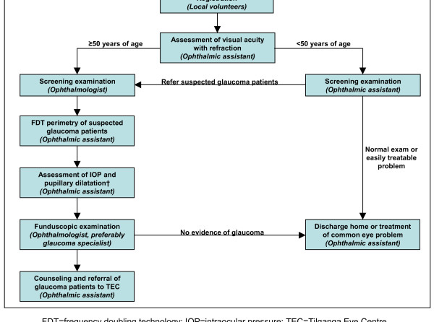

Slide 37
Treatment
Beta blockers: 1st line of treatment
Additional drugs: Issues regarding costs
Primary Surgery
Ask patients about affordability

Slide 38
Glaucoma Education & Awareness Programs
(2003)
Glaucoma Support Group Activities
- 6 education classes / year
Annual Glaucoma Awareness Week
- Free investigations and treatment
- Information Booklets

Slide 39
Impact of GSG and Awareness Programs
(2004- 2011)
Total number of patients examined during
Glaucoma Awareness Week
Number of participants during patient
education programs
Financial support extended by patients attending support group classes towards the treatment of patients

Slide 40
Research
Nepal Angle Closure Glaucoma Study
(NACGS, 2012 -2015)
3 year Prospective, Surgical Trial
To evaluate the outcomes of Cataract removal vs. Trabeculectomy or Combined surgery in the treatment of ACG
Bhaktapur Retinal Study
(BRS, 2013- 2017)
Diabetic Rp, AMD, Venous occlusions
5 year Follow Up of BGS patients (Longitudinal / Prospective
Cohort)

Slide 41
Conclusion
What we know
Glaucoma blindness will increase with aging population
PACG causes more visual morbidity than POAG
What we should focus on
Case Detection & Opportunistic Screening
Treatment, economics

Slide 42
Raising awareness on glaucoma
Training Human Resource
Research
What we hope to expect
Cataract intervention programs :
Can it help prevent ACG at its early stage and prevent ACG blindness?

Slide 43
Tertiary Level
Glaucoma Specialists
General Ophthalmologists
Sub-specialty Service
(programs)
11 CECs
OAs
1 Secondary Level Hospital
General Ophthalmologist
2 CEC
OAs
Validate OA Training Programs
Case detect at community level
Promote Awareness

Slide 44

Bauddhanath, Kathmandu, Nepal

Slide 45
2003
One of the first with a Fellowship in Glaucoma in Nepal
Glaucoma Fellowship at RVEEH, Melbourne
Prof Hugh Taylor
Trained under 6 glaucoma specialists in one institution

Slide 46
Raising awareness on glaucoma
Training Human Resource
Research
What we hope to expect
Cataract intervention programs
Could it help prevent ACG at its early stage and prevent ACG blindness?

Slide 47
Achievement
Description | 1981 | 2010
Prevalence of Blindness | 0.84 % | 0.39 %
Number of Eye Hospital | 1 | 21
PEC/ CEC | 0 | 63
Ophthalmologist | 5 | 147
Cataract Prevalence | 72 % | 65%
Retinal disorder due to Diabetic | NA | 10000
Gap of Human Resource
Description | Existing | Required | Gap
Ophthalmologist | 150 | 570 | 420
Optometrist | 36 | 570 | 534
Ophthalmic Assistant | 275 | 1,140 | 565
Trained PHC Workers | 201* | 5,700

Slide 48
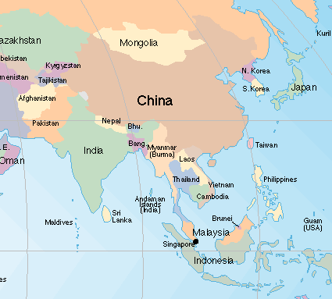
South Asia
?
?
? Glaucoma Blindness
7.1 %
(2007)
POAG –1.2 %
PACG – 0.4 %
(Thapa, 2010)
POAG – 2.5%
PACG – 0.4%
(Foster, 1996)
?
POAG – 2.3%
PACG – 0.5 %
(Casson, 2009)
POAG – 2.0%
PACG – 2.5%
(Casson, 2007)

Slide 49
Females, > 60 years of age, short axial lengths
could develop PACG
LPI, Early cataract extraction
can be considered in high risk patients

Slide 50
India
POAG – 1.62%
PACG – 1.08%
(Dandona, 2000)
POAG – 1.62%
PACG – 0.9 %
(Vijaya, 2005/6)
POAG – 0.41%
PACG – 4.62%
(Jacob, 1998)
POAG – 1.7%
PACG – 0.5%
(Ramakrishnan, 2003)

Slide 51
Glaucoma in India
Estimated burden of disease
Approximately 11.2 million persons aged > 40 with glaucoma
POAG is estimated to affect 6.5 million persons
PACG is estimated to affect 2.5 million persons
George R et al. J Glaucoma 2010

Slide 52
Demographic Profile
Total Sample Size : 4800; ≥ 40 years
Male: Female = 51 : 48 %
Ethnic Race : Newar, 70 %

Slide 53
Methods
Applanation tonometry, gonioscopy
FDP, Dilated pupil examination
Axial length measurements
HFA
Thapa SS et al. Clinic Exp Ophthal 2010

Slide 54
POAG
Prevalence > PACG (BGS)
VI < PACG
IOP - > 90 % within normal range (BGS)
- Raised IOP (HBS)
Secondary Glaucoma
NVG & Lens Induced

